Slide 1
Chapter 3: The Data Link Layer

Slide 2
Data Link Layer
Reliable bitstream between adjacent computers
  Design Issues
  Error Detection and Correction
  Elementary Protocols
  Sliding Window Protocols Protocol Verification
  Example Data Link Protocols

Slide 3
Design Issues
Provides an interface to network layer Deals with transmission errors
Regulates flow of data so slow receivers are not swamped
Topics
Services
Framing Error control Flow control

Slide 4
Terminology: Packets and Frames
Sending machine
Receiving machine
Network
Packet
Packet
Frame
Data Link
Header | Payload field | Trailer
Header | Payload field | Trailer

Slide 5






Layered Communication
Host 1
Host 2
Host 1
Host 2
4
4
4
4
ath
3
3
3
3
Virtual
data p
2
2
2
2
1
1
1
Ac
th
1
tual
data pa

Slide 6
Kinds of Services
Unacknowledged connectionless service
no error detection or recovery appropriate when error rate is very low
real-time – late data are worse than bad data
Acknowledged connectionless service
each packet is acknowledged
retransmit after timeout expires optimization when errors are frequent
Acknowledged connection-oriented service
number frames to detect duplicates
connection setup, transmission, connection release

Slide 7



The Data Link Layer in
Example: Context
Router
Data link layer process
Routing process
2
2
3
2
2
3
Data link protocol
Frames Packets here here
Transmission line to a router

Slide 8
Framing (1 of 3)
How to mark the start and end of each frame?
Character count: field in header for frame size
transmission errors are problematic
Character count One character
(a)
5 | 1 | 2 | 3 | 4 | 5 | 6 | 7 | 8 | 9 | 8 | 0 | 1 | 2 | 3 | 4 | 5 | 6 | 8 | 7 | 8 | 9 | 0 | 1 | 2 | 3
Frame 1
5 characters
Frame 2
5 characters
Frame 3
8 characters
Frame 4
8 characters
Error
(b)
5 | 1 | 2 | 3 | 4 | 7 | 6 | 7 | 8 | 9 | 8 | 0 | 1 | 2 | 3 | 4 | 5 | 6 | 8 | 7 | 8 | 9 | 0 | 1 | 2 | 3
Frame 1
Frame 2 (Wrong)
Now a character count

Slide 9
Framing (2 of 3)
2. Flag bytes: two consecutive flags indicates end and start of frame
flag bytes
FLAG | Header | Payload field | Trailer | FLAG
escape conventions (stuffing)
Original characters
After stuffing
A
FLAG
B
A
ESC
FLAG
B
A
ESC
B
A
ESC
ESC
B
A
ESC
FLAG
B
A
ESC
ESC
ESC
FLAG
B
A
ESC
ESC
B
A
ESC
ESC
ESC
ESC
B

Slide 10
Framing (Byte Stuffing)
Problem 3. The following data fragment occurs in the middle of a data stream for which the bytestuffing algorithm described in the text is used:
A B ESC C ESC FLAG FLAG D.
What is the output after stuffing?
Solution: After stuffing, we get
A B ESC ESC C ESC ESC ESC FLAG ESC FLAG D.

Slide 11
Framing (3 of 3)
Flags with bit stuffing
Flag is 01111110
(a) 0 1 1 0 1 1 1 1 1 1 1 1 1 1 1 1 1 1 1 1 0 0 1 0
(b) 0 1 1 0 1 1 1 1 1 0 1 1 1 1 1 0 1 1 1 1 1 0 1 0 0 1 0
Stuffed bits
(c) 0 1 1 0 1 1 1 1 1 1 1 1 1 1 1 1 1 1 1 1 0 0 1 0
Physical layer coding violations
physical layer provides a “frame” service

Slide 12
Error Control
Receiver provides feedback in the form of positive or negative acknowledgements (ACKs)
Dropped frames are handled using timeouts
Dropped transmissions or ACKs are handled by retransmitting
Duplicate frames are handled using sequence numbers

Slide 13
Flow Control
->Slowing down a fast sender
feedback-based flow control
rate-based flow control

Slide 14
Data Link Layer
Reliable bitstream between adjacent computers
  Design Issues
  Error Detection and Correction
  Elementary Protocols
  Sliding Window Protocols Protocol Verification
  Example Data Link Protocols

Slide 15
3.2 Error Detection and Correction
Network designers have developed two basic strategies for dealing with errors. Both add redundant information to the data that is sent.
One strategy is to deduce what the transmitted data must have been: Error Correction
The other is to only deduce that an error has occurred (but not which error); Error Detection
Neither error-correcting codes nor error-detecting codes can handle all possible errors.
Error correcting is used on unreliable links
Error detecting (enough to know something went wrong) is used on reliable links. Just retransmission.

Slide 16
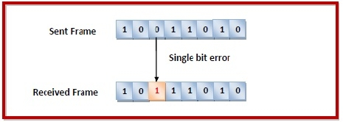
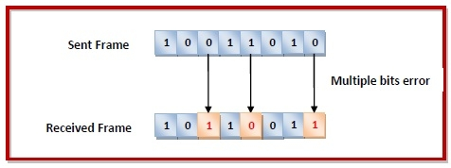
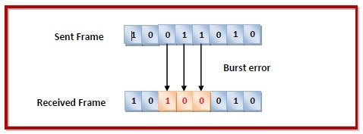
3.2 Error Detection and Correction
Types of Errors: Errors can be of three types, namely single bit errors, multiple bit errors, and burst errors.
Single bit error − In the received frame, only one bit has been corrupted, i.e. either changed from 0 to 1 or from 1 to 0.
Multiple bits error − In the received frame, more than one bits are corrupted.
Burst error − In the received frame, more than one consecutive bits are corrupted.

Slide 17
3.2 Error Detection and Correction
We will examine three different error-detecting codes. They are all linear, systematic block codes:
  1. Parity.
  2. Checksums.
  3. Cyclic Redundancy Checks (CRCs).
Parity Check
The parity check is done by adding an extra bit, called parity bit to the data to make a number of 1s either even in case of even parity or odd in case of odd parity.
In case of even parity: If a number of 1s is even then parity bit value is 0. If the number of 1s is odd then parity bit value is 1.
In case of odd parity: If a number of 1s is odd then parity bit value is 0. If a number of 1s is even then parity bit value is 1.
The parity check is suitable for single bit error detection only.
Notes:
On receiving a frame, the receiver counts the number of 1s in it. In case of even parity check, if the count of 1s is even, the frame is accepted, otherwise, it is rejected. A similar rule is adopted for odd parity check.

Slide 18
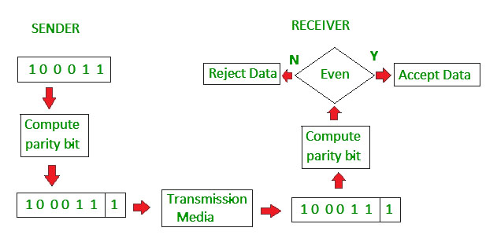
3.2 Error Detection and Correction
Even parity

Slide 19
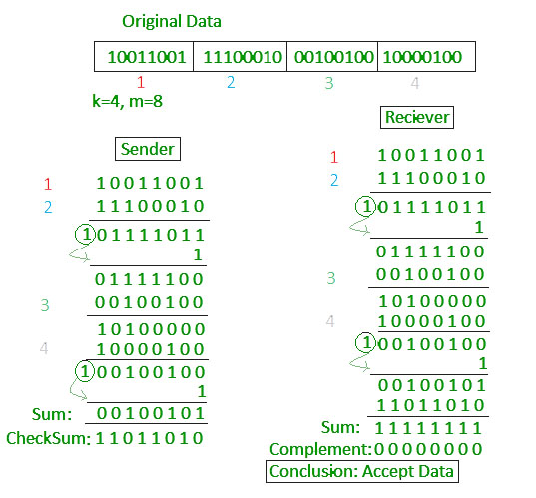
Checksum
The data is divided into k segments each of m bits.
In the sender’s end the segments are added using 1’s complement arithmetic to get the sum. The sum is complemented to get the checksum.
The checksum segment is sent along with the data segments.
At the receiver’s end, all received segments are added using 1’s complement arithmetic to get the sum. The sum is complemented.
If the result is zero, the received data is accepted; otherwise discarded.

Slide 20
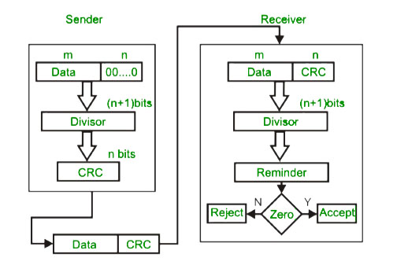
Cyclic redundancy check (CRC)
Unlike checksum scheme, which is based on addition, CRC is based on binary division.
In CRC, a sequence of redundant bits, called cyclic redundancy check bits, are appended to the end of data unit so that the resulting data unit becomes exactly divisible by a second, predetermined binary number.
At the destination, the incoming data unit is divided by the same number. If at this step there is no remainder, the data unit is assumed to be correct and is therefore accepted.
A remainder indicates that the data unit has been damaged in transit and therefore must be rejected.

Slide 21
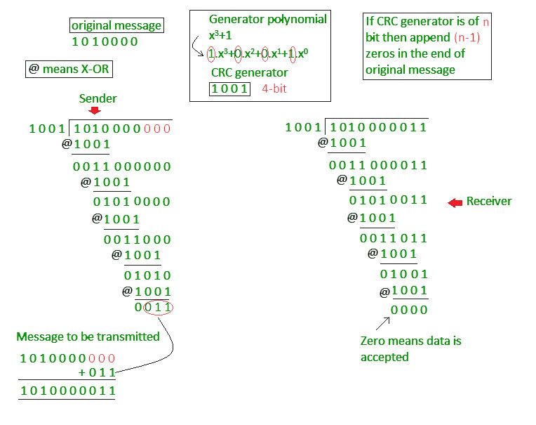

Slide 22
Hamming Codes, 1950
3.2 Error Detection and Correction
Codeword, n bits = m message (data) bits + r redundant (check) bits
A code is a set of codewords; consider a code with only four valid codewords:
  0000000000, 0000011111, 1111100000, and 1111111111
Hamming distance
  count of corresponding bits that differ
  e.g., 10001001 and 10110001 have distance 3
  10001001
  Xor 10110001
  00111000
  if distance is d, d single bit errors are needed to convert one to the other

Slide 23
Hamming Codes Definitions
The Hamming distance for a set of code words is the minimum Hamming distance for any two codewords in the code. For these 4 codewords, what is the hamming distance?
0000000000, 0000011111, 1111100000, and 1111111111
To detect d single bit errors, the code must have distance d+1
To correct d single bit errors, the code must have distance 2d+1, to ensure that the original codeword is closer than any other

Slide 24
Hamming Codes
To correct d single bit errors, the code must have distance 2d+1, to ensure that the original codeword is closer than any other
0000000000, 0000011111, 1111100000, and 1111111111
But the arrived codeword is 0000000111
Here, Hamming distance: 5 ( value of d=2)
So double bit error can be corrected. So, the original must have been 0000011111

Slide 25

Hamming Codes
Attaining a code with minimal n
Bits 1, 2, 4, 8, 16, . . . are used as parity bits
Bits 3, 5, 6, 7, 9, 10, 11, . . . are used for the message
For k ∑ c_{i}2^{i}, bit is position k is checked by bit in positions 2^{i} where c_{i} 0

Slide 26
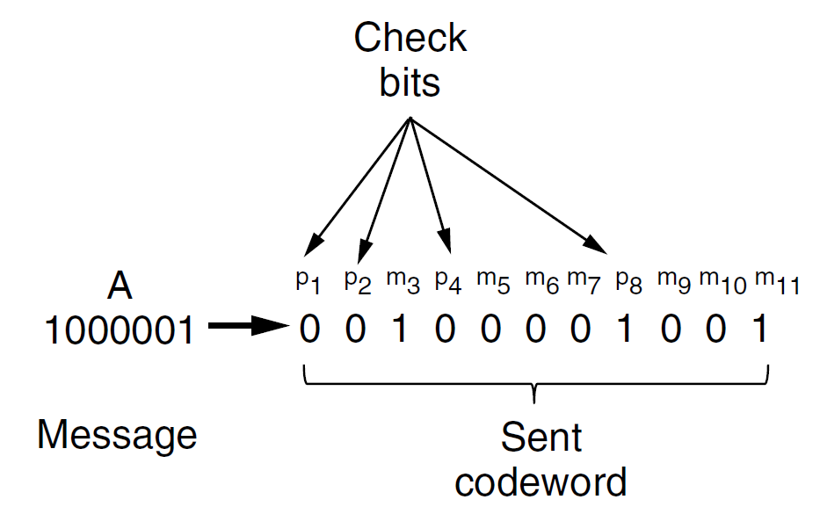
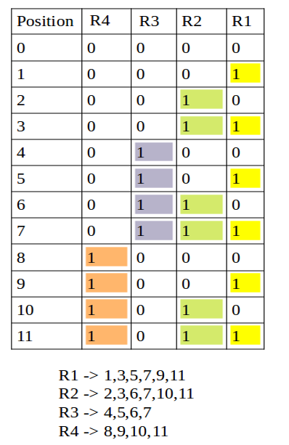
Hamming Codes (5 of 8)
1 | 2 | 3 | 4 | 5 | 6 | 7 | 8 | 9 | 10 | 11
 |  | 1 |  | 0 | 0 | 0 |  | 0 | 0 | 1
P1: 10001( p1 will be 0 to make it even)
P2: 10001(p2 will be 0 to make it even parity)
P4: 000( p4 =0)
P8: 001( p8=1)

Slide 27
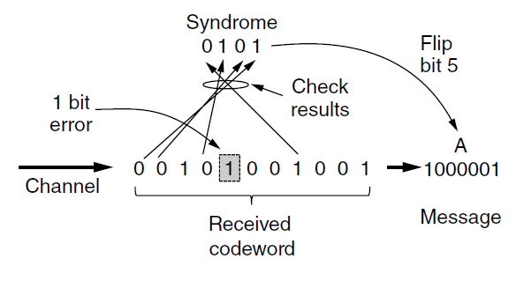
Hamming Codes
p1 | p2 | m3 | p4 | m5 | m6 | m7 | p8 | m9 | m10 | m11
0 | 0 | 1 | 0 | 1 | 0 | 0 | 1 | 0 | 0 | 1
Similar Even parity calculation to find the position:
R1: 011001( R1 should be1 to make it even)
R2: 10001(R2 should be 0 to make it even )
R3: 0100( R3 should be 1)
R4: 1001( R4 should be 0)
Error found in 0101 position
**R1,R2,R3 represent the redundant bits, it can also be known as parity bit

Slide 28
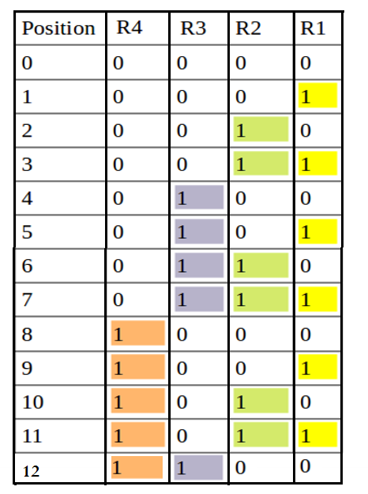
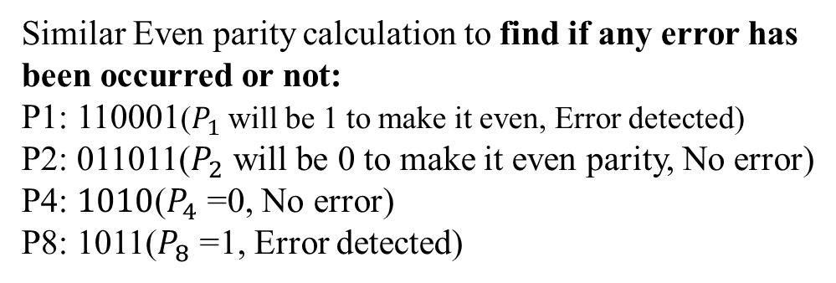
Sender and Receiver have agreed upon Hamming code for error correction. Now at a certain time receiver has received the following message.
101101010110
Find out the position in which the error occurred if any error is detected.
P1 | p2 | m3 | p4 | m5 | m6 | m7 | p8 | m9 | m10 | m11 | m12
1 | 0 | 1 | 1 | 0 | 1 | 0 | 1 | 0 | 1 | 1 | 0
Similar Even parity calculation to find if any error has been occurred or not:
P1: 110001($P_{1}$ will be 1 to make it even, Error detected)
P2: 011011($P_{2}$ will be 0 to make it even parity, No error)
P4: $1010$($P_{4}$ =0, No error)
P8: 1011($P_{8}$ =1, Error detected)
P1/R1→ 1,3,5,7,9,11
P2/R2→ 2,3,6,7,10,11
P4/R3→ 4,5,6,7,12
P8/R4→ 8,9,10,11,12
If the Calculated Parity or check bit is ‘1’, error is detected.
Now lets find out, where the error is. Error found at $P_{8}$ $P_{4}$ $P_{2}$ $P_{1}=1001=9^{th} position$

Slide 29
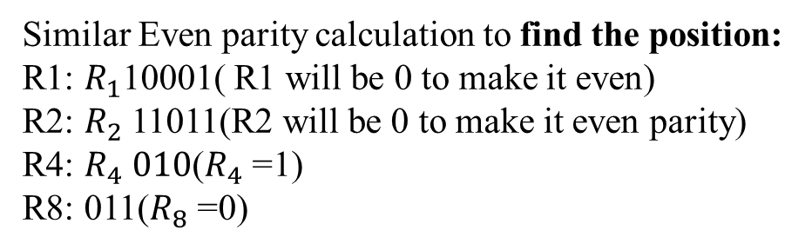
Sender and Receiver have agreed upon Hamming code for error correction. Now at a certain time receiver has received the following message.
101101010110
Find out the position in which the error occurred if any error is detected.
1 | 2 | 3 | 4 | 5 | 6 | 7 | 8 | 9 | 10 | 11 | 12
1 | 0 | 1 | 1 | 0 | 1 | 0 | 1 | 0 | 1 | 1 | 0
Similar Even parity calculation to find the position:
R1: $R_{1}$10001( R1 will be 0 to make it even)
R2: $R_{2}$11011(R2 will be 0 to make it even parity)
R4: $R_{4} 010$($R_{4}$ =1)
R8: 011($R_{8}$ =0)
P1/R1→ 1,3,5,7,9,11
P2/R2→ 2,3,6,7,10,11
P4/R3→ 4,5,6,7,12
P8/R4→ 8,9,10,11,12
Error found in 0100 position

Slide 30
3.3 Elementary Protocols
Utopia
Simplex Stop-and-Wait
Positive Acknowledgement with Retransmission
1 1 1 0

Slide 31
Utopia
void sender1( void )
{
frame s; packet buffer;
while( true ) { from_net_layer( &buffer ); s.info = buffer; to_phy_layer( &s );
}
}
void receiver1( void )
{
frame r; event_type event;
while( true ) { wait_for_event( &event ); from_phys_layer( &r ); to_net_layer( &r.info );
}
}
1 1 1 0

Slide 32
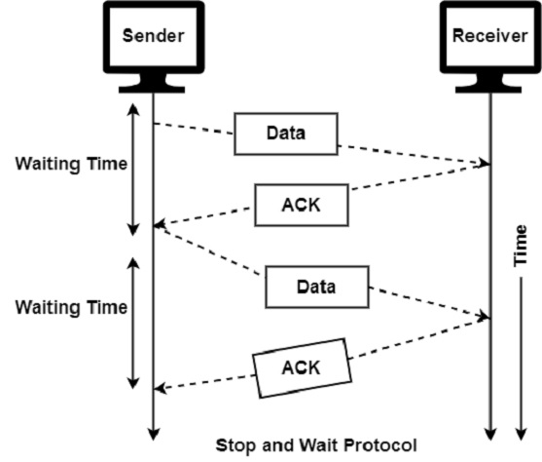
Stop-and-Wait
1 1 1 0

Slide 33
Stop-and-Wait
void sender2( void )
{
frame s; packet buffer;
event_type event;
while( true ) { from_net_layer( &buffer ); s.info = buffer; to_phy_layer( &s ); wait_for_event( &event );
}
}
void receiver2( void )
{
frame r,s; event_type event;
while( true ) { wait_for_event( &event ); from_phys_layer( &r ); to_net_layer( &r.info ); to_phy_layer( &s );
}
}
1 1 1 0

Slide 34
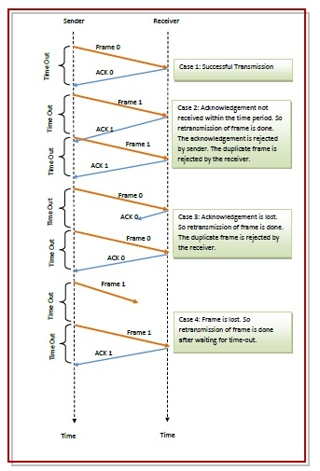
Stop-and-Wait Noisy Channel
1 1 1 0

Slide 35
Positive Acknowledgement with Retransmission
void sender3( void )
{
seq_nr next_frame_to_send; frame s;
packet buffer; event_type event;
next_frame_to_send = 0; from_net_layer( &buffer ); while( true ) {
s.info = buffer;
s.seq = next_frame_to_send; to_phy_layer( &s ); set_timer( s.seq ); wait_for_event( &event );
if( event == frame_arrival ) { from_phys_layer( &s );
if( s.ack == next_frame_to_send ) {
stop_timer( s.ack ); from_net_layer( &buffer ); inc( next_frame_to_send );
}
}
}
}
void receiver3( void )
{
seq_nr frame_expected; frame r,s;
event_type event;
frame_expected = 0;
while( true ) { wait_for_event( &event );
if( event == frame_arrival ) { from_phys_layer( &r );
if( r.seq == frame_expected ) {
to_net_layer( &r.info ); inc( frame_expected );
}
s.ack = 1 – frame_expected; to_phy_layer( &s );
}
}
}
Chapter 3 – p.35/69

Slide 36
**3.4 Sliding Window Protocols
Piggybacking
One-Bit Sliding Window Go Back N
Selective Repeat

Slide 37
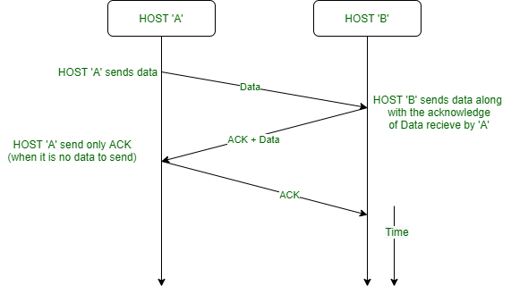
Piggybacking

Slide 38
Piggybacking
Wasted bandwidth on ACK channel
Interleave ACKs in reverse data channel (it’s probably there)
Piggybacking–add ACKs in the header of outgoing data packets
Issue: how long to wait for an outgoing data packet

Slide 39
Sliding Window of Size 1
Sender
 |  | 7 | 0 |  |  |  |  | 7 | 0 |  |  |  |  | 7 | 0 |  |  |  |  | 7 | 0
6 |  |  |  |  | 1 | 6 |  |  |  |  | 1 | 6 |  |  |  |  | 1 | 6 |  |  |  |  | 1
5 |  |  |  |  | 2 | 5 |  |  |  |  | 2 | 5 |  |  |  |  | 2 | 5 |  |  |  |  | 2
 |  | 4 | 3 |  |  |  |  | 4 | 3 |  |  |  |  | 4 | 3 |  |  |  |  | 4 | 3
Receiver
7
0
7
0
7
0
7
0
6
1
6
1
6
1
6
1
5
2
5
2
5
2
5
2
4
3
4
3
4
3
4
3
(a) (b) (c) (d)
(a) initial; (b) after first frame sent; (c) first frame received; (d) first frame acknowledged

Slide 40
One-Bit Sliding Window Initialization
void protocol4( void )
{
seq_nr next_frame_to_send, frame_expected; frame r, s;
packet buffer; event_type event;
next_frame_to_send = 0;
frame_expected = 0; from_net_layer( &buffer ); s.info = buffer;
s.seq = next_frame_to_send;
s.ack = 1 - frame_expected; to_phys_layer( &s ); start_timer( s.seq );

Slide 41
One-Bit Sliding Window Main Loop
while( true ) { wait_for_event( &event );
if( event == frame_arrival ) { from_physical_layer( &r );
if( r.seq == frame_expected ) {
to_net_layer( &r.info ); inc( frame_expected );
}
if( r.ack == next_frame_to_send ) { stop_timer( r.ack );
from_net_layer( &buffer ); inc( next_frame_to_send );
}
}
s.info = buffer;
s.seq = next_frame_to_send; s.ack = 1 - frame_expected;
to_phys_layer( &s ); start_timer( s.seq );
}
Chapter 3 – p.41/69

Slide 42
One-Bit Sliding Window Normal Case
Notation: (sequence, ack, packet)
A sends (0, 1, A0)
B gets (0, 1, A0)*
B sends (0, 0, B0)
A gets (0, 0, B0)*
A sends (1, 0, A1)
B gets (1, 0, A1)*
B sends (1, 1, B1)
A gets (1, 1, B1)*
A sends (0, 1, A2)
B gets (0, 1, A2)*
B sends (0, 0, B2)
A gets (0, 0, B2)*
A sends (1, 0, A3)
B gets (1, 0, A3)*
B sends (1, 1, B3)
Time
An asterisk indicates where a network layer accepts a packet.

Slide 43




One-Bit Sliding Window Degenerate Case
A sends (0, 1, A0)
A gets (0, 1, B0)*
A sends (0, 0, A0)
B sends (0, 1, B0)
B gets (0, 1, A0) *
B sends (0, 0, B0)
B gets (0, 0, A0)
B sends (1, 0, B1)
B gets (1, 0, A1)*
B sends (1, 1, B1)
B gets (1, 1, A1)
B sends (0, 1, B2)
A gets (0, 0, B0)
A sends (1, 0, A1)
A gets (1, 0, B1)*
A sends (1, 1, A1)
Half of the frames contain duplicates, even though there are no transmission errors.

Slide 44

Pipelining
The technique of keeping multiple frames in flight is an example of pipelining.
Want to avoid stalls in transmission
in one-bit sliding window, we wait a full round trip between
packet sends
Make sender window large when:
bandwidth is high or
the round-trip time is high bandwidth x round-trip time
line utilization =
l /(l bR)
l is the frame size (in bits)
b is the channel capacity (in bits/sec)
R is the round-trip time (in sec)
If l<bR the efficiency is less than 50%

Slide 45
Receiver Window Size is One
Pipelining frames over an unreliable communication channel raises some serious issues.
First, what happens if a frame in the middle of a long stream is damaged or lost?
  Large numbers of succeeding frames will arrive at the receiver before the sender even finds out that anything is wrong.
Timeout interval
Dealing with Error
0
1
2
3
4
5
6
7
8
2
3
4
5
6
7
8
9
Ack 0
Ack 1
Ack 2
Ack 3
Ack 4
Ack 5
Ack 6
Ack 7
0
1
E D D D D D D
Frames discarded by data link layer
2
3
4
5
6
7
8
Error
Time
Leads to Go-back n

Slide 46
Receiver’s Window is Large
Dealing with Error
0
1
2
3
4
5
2
6
7
8
9
10
11
12
13
14
15
Nak 2
Ack 1
Ack 1
Ack 5
Ack 6
Ack 7
Ack 0
Ack 1
Ack 8
Ack 9
Ack 10
Ack 11
Ack 12
Ack 13
0
1
E
3
4
5
2
6
7
8
9
10
11
12
13
14
Error
Frames buffered by data link layer
Leads to selective repeat (So in Selective Repeat Receiver window is larger than one)
tradeoff bandwidth and buffer capacity

Slide 47
Go Back n Off by one
Can only have MAX_SEQ Frames in flight (not MAX_SEQ + 1)
Consider MAX_SEQ = 7
Sender sends frames 0 through 7 Receiver acknowledges frame 7
Sender sends the next 8 frames with sequence numbers 0 though 7
Another acknowledgement for frame 7 arrives
Is this an acknowledgement for the first group or the second?

Slide 48
Managing Multiple Timers
Real time
10:00:00.0
10:00:00.5
5
1
8
2
6 | 3
8
2
6 | 3
Pointer to next timeout Frame being timed Ticks to go
(a)
(b)

Slide 49
Problem for Selective Repeat
Do not allow sender to overlap sequence numbers in consecutive windows
Sender
0 1 2 3 4 5 6
7
0 1 2 3 4 5 6
7
0 1 2 3
4 5 6 7
0 1 2 3
4 5 6 7
Receiver
0 1 2 3 4 5 6
7
0 1 2 3 4 5
6
7
0 1 2 3
4 5 6 7 0 1 2 3
4 5 6 7
(a) (b) (c) (d)
(a) initial situation window size is 7; (b) 7 frames sent, received, but not acknowledged;
(c) initial situation, widow size is 4; (d) all frames sent,
received, but not acknowledged

